Slide 1

Preparation for Lab 3
Week 6
Semester 1, 2025
Dr. Farshid Keivanian

Slide 2
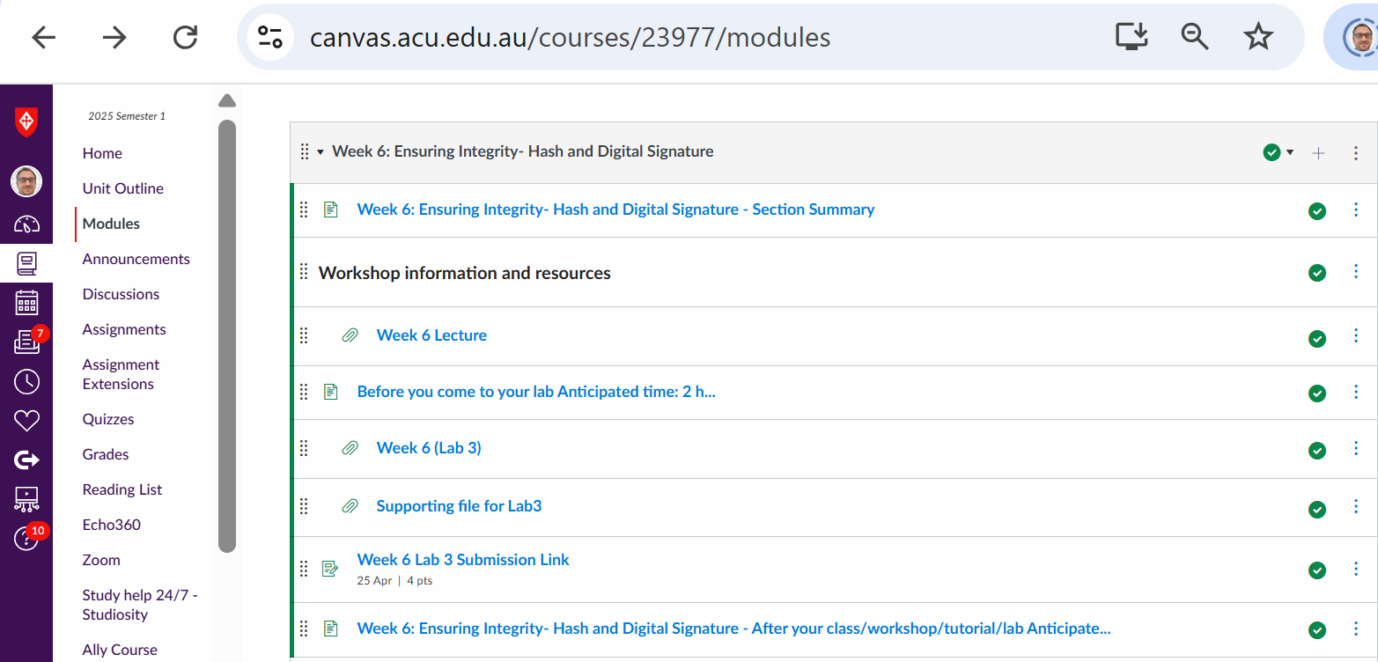
Preparation for Lab 3 (Week 6)
Navigate Canvas >> Week 6 >> Lab 3

Slide 3
Preparation for Lab 3 (Week 6) - Classical and Modern Cryptography with CrypTool
Lab Overview
This lab introduces core cryptographic concepts with an emphasis on both theoretical understanding and hands-on practice using CrypTool. Students will explore key encryption principles like confusion and diffusion, analyze the Feistel cipher structure, and compare DES, AES, and RSA cryptographic algorithms. Finally, they will engage in encryption and decryption using RSA manually and Caesar cipher using the interactive CrypTool 1.4.41/1.4.42 tool.

Slide 4
Preparation for Lab 3 (Week 6) - Classical and Modern Cryptography with CrypTool
Goals and Learning Outcomes
By the end of this lab, you will be able to:
Define and distinguish between core cryptographic principles (e.g., confusion, diffusion)
Understand the structure of symmetric and asymmetric algorithms
Perform RSA key generation and encrypt/decrypt messages manually
Decrypt Caesar cipher messages using CrypTool manually and automatically
Appreciate the vulnerabilities of classical ciphers via brute-force techniques
Enhance problem-solving and analysis skills through cryptanalysis experiments

Slide 5
Preparation for Lab 3 (Week 6) - Classical and Modern Cryptography with CrypTool
When we talk about how encryption hides information, we usually focus on two key ideas that were introduced by Claude Shannon, the father of modern cryptography:
Confusion = Make the relationship between the key and the output (ciphertext) hard to figure out.
Diffusion = Spread the plaintext’s influence all over the ciphertext, so patterns disappear.

Slide 6
Preparation for Lab 3 (Week 6) - Classical and Modern Cryptography with CrypTool
Think of it like cooking a stew:
Confusion is like adding strong spices—you can’t easily taste what ingredient does what.
Diffusion is like stirring well—you don’t get a spoonful with just salt or just pepper.

Slide 7
Preparation for Lab 3 (Week 6) - Classical and Modern Cryptography with CrypTool
1. Confusion – Example
What does it mean?
We want the ciphertext to be so scrambled that even if someone sees a part of it, they can’t guess the key.

Slide 8
Preparation for Lab 3 (Week 6) - Classical and Modern Cryptography with CrypTool
Numerical Example:
Let’s say we use this simplified substitution cipher:
The key is: A → M, B → N, C → O, … (Shift each letter by +12)
If we encrypt the word "BAD":
Plaintext | Encrypted
B | N
A | M
D | P

Slide 9
Preparation for Lab 3 (Week 6) - Classical and Modern Cryptography with CrypTool
Now, if someone looks at this and sees "NMP", they still can't easily tell the original letters, or how the letters were shifted—especially if we don't tell them that we’re using a shift of 12. That’s confusion.
Real-World Context:
Imagine logging into your bank, and every time, the encryption changes slightly even if your password is the same. That makes it super confusing for hackers. They can’t reverse-engineer the key from the output.

Slide 10
Preparation for Lab 3 (Week 6) - Classical and Modern Cryptography with CrypTool
2. Diffusion – Example
❓ What it means:
We want to spread the influence of each character in the plaintext across the ciphertext, so changing even one letter changes everything.

Slide 11
Preparation for Lab 3 (Week 6) - Classical and Modern Cryptography with CrypTool
Numeric Example:
Let’s say we use a block cipher like AES. If your input block is:
HELLO123 → gets turned into X9W3PZLQ
Now change just one letter in the plaintext to HELP0123.
Instead of just one letter changing in the ciphertext, you might get:
M2JY8LK9
See that? Everything changed! That’s diffusion.

Slide 12
Preparation for Lab 3 (Week 6) - Classical and Modern Cryptography with CrypTool
Real-World Context:
Think of a social media password: you mistype just one letter, and the encrypted version is completely different. That makes it very hard for attackers to spot patterns between similar passwords.

Slide 13
Preparation for Lab 3 (Week 6) - Classical and Modern Cryptography with CrypTool
Summary Table:
Concept | Goal | Simple Analogy | Numeric Example
Confusion | Hide the connection between key & ciphertext | Strong spices in a recipe | "BAD" → "NMP" using shift +12
Diffusion | Spread input changes across the output | Stirring soup so flavors mix well | "HELLO123" → "X9W3PZLQ" "HELP0123" → "M2JY8LK9"

Slide 14
Preparation for Lab 3 (Week 6) - Classical and Modern Cryptography with CrypTool
Encrypt a short word using a shift cipher and change just one character
Observe how the result differs (→ supports diffusion)
Use CrypTool to visualise both cases!

Slide 15
Preparation for Lab 3 (Week 6) - Classical and Modern Cryptography with CrypTool
Feistel Cipher Structure – Explained with Example
What Is It?
The Feistel Cipher is a basic structure used in many symmetric encryption algorithms like DES. It's powerful because it makes encryption reversible even when using simple functions.

Slide 16
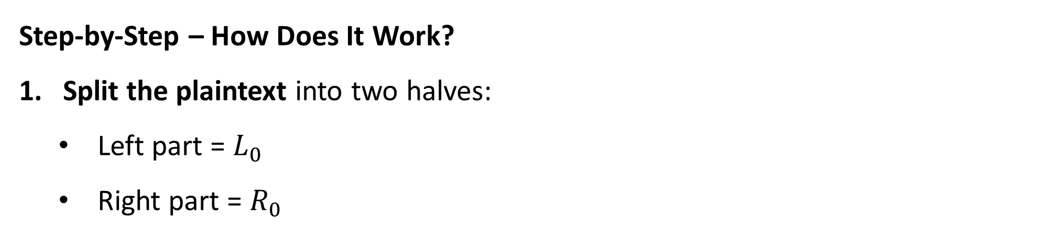
Preparation for Lab 3 (Week 6) - Classical and Modern Cryptography with CrypTool
Step-by-Step – How Does It Work?
Split the plaintext into two halves:
Left part = $L_{0}$
Right part = $R_{0}$

Slide 17
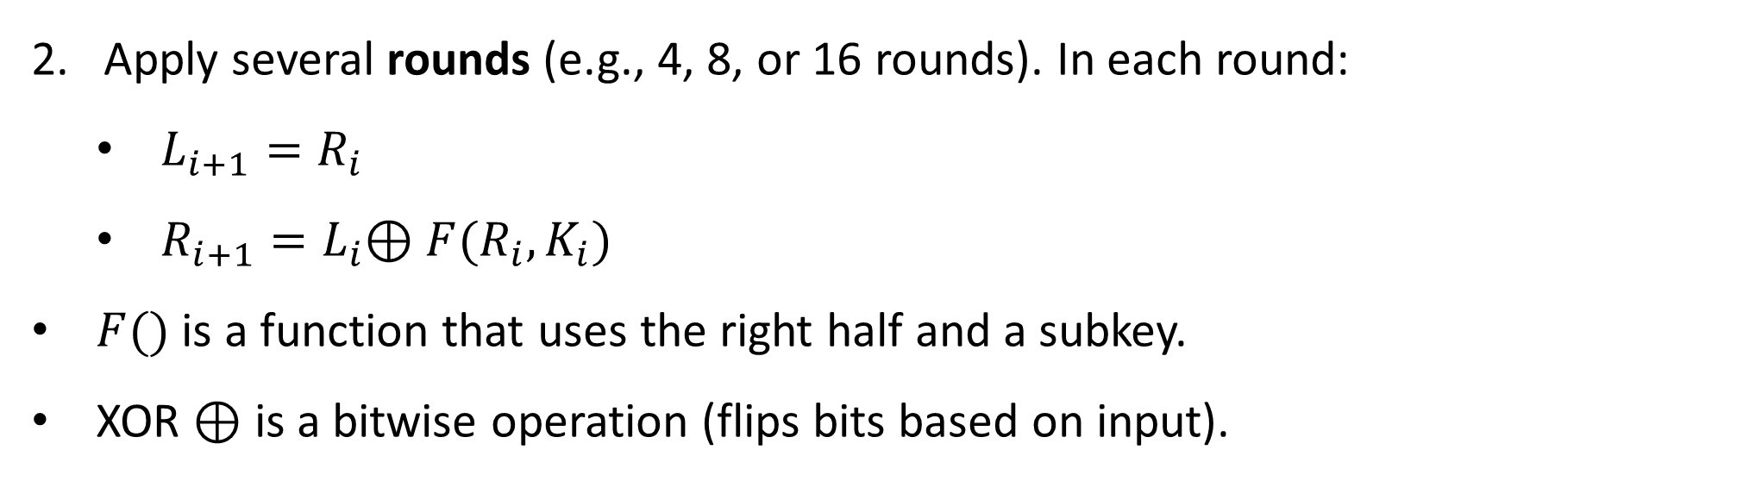
Preparation for Lab 3 (Week 6) - Classical and Modern Cryptography with CrypTool
Apply several rounds (e.g., 4, 8, or 16 rounds). In each round:
$L_{i+1}=R_{i}$
$R_{i+1}=L_{i}$⊕ $F(R_{i},K_{i})$
$F()$ is a function that uses the right half and a subkey.
XOR ⊕ is a bitwise operation (flips bits based on input).

Slide 18
Preparation for Lab 3 (Week 6) - Classical and Modern Cryptography with CrypTool
Numeric Example (2 Rounds)
Let’s encrypt the number "11010100" (8-bit binary string):
Split it into:
L₀ = 1101
R₀ = 0100
Choose two simple keys:
K₁ = 0011
K₂ = 1001

Slide 19
Preparation for Lab 3 (Week 6) - Classical and Modern Cryptography with CrypTool
Round 1:
L₁ = R₀ = 0100
R₁ = L₀ XOR (R₀ + K₁) = 1101 XOR (0100 + 0011) = 1101 XOR 0111 = 1010
So, after Round 1: → L₁ = 0100, R₁ = 1010

Slide 20
Preparation for Lab 3 (Week 6) - Classical and Modern Cryptography with CrypTool
Round 2:
L₂ = R₁ = 1010
R₂ = L₁ XOR (R₁ + K₂) = 0100 XOR (1010 + 1001) = 0100 XOR 0011 = 0111
So, final output (after 2 rounds): → L₂ = 1010, R₂ = 0111 → Ciphertext = 10100111

Slide 21
Preparation for Lab 3 (Week 6) - Classical and Modern Cryptography with CrypTool
Real-World Analogy
Think of encryption like passing a secret message in class:
You split the message into two parts (L and R).
In each round, the left and right swap roles.
The right side is changed using a function and the secret key, kind of like passing it through a logic puzzle.
After a few rounds, it becomes unreadable.
BUT – when decrypting, you just reverse the process, and everything comes back to normal. That’s the beauty of the Feistel structure: easy to reverse!

Slide 22
Preparation for Lab 3 (Week 6) - Classical and Modern Cryptography with CrypTool
Why It's Useful?
Easy to decrypt (just run the rounds in reverse)
Makes secure ciphers like DES possible
Works even if the function F() isn’t reversible

Slide 23
Preparation for Lab 3 (Week 6) - Classical and Modern Cryptography with CrypTool
Simple Summary for Students:
Feistel Cipher splits the data into two, keeps flipping and changing the parts in each round using XOR and keys. At the end, you get ciphertext. To decrypt, flip it back step-by-step!

Slide 24
Preparation for Lab 3 (Week 6) - Classical and Modern Cryptography with CrypTool
DES vs. AES
Aspect | DES | AES
Block size | 64 bits | 128 bits
Key size | 56 bits | 128/192/256 bits
Rounds | 16 | 10/12/14
Security | Low (brute-forceable) | High (widely used and secure)
Performance | Slower on modern systems | Fast and secure on all platforms

Slide 25
Preparation for Lab 3 (Week 6) - Classical and Modern Cryptography with CrypTool
Key Takeaway: AES is the winner. Here’s why:
Security
DES’s 56-bit key is too short by today’s standards. It can be brute-forced in hours or minutes using modern computing power.
AES offers stronger keys (128/192/256-bit), which makes brute-force attacks practically impossible today.

Slide 26
Preparation for Lab 3 (Week 6) - Classical and Modern Cryptography with CrypTool
Performance
DES was designed in the 1970s for older hardware and runs slower on modern systems.
AES was built with modern systems in mind. It’s faster and more efficient, especially for devices like phones, laptops, or cloud servers.

Slide 27
Preparation for Lab 3 (Week 6) - Classical and Modern Cryptography with CrypTool
Block Size
AES uses a larger block size (128 bits vs. 64 bits), which helps improve security and performance for large amounts of data.

Slide 28
Preparation for Lab 3 (Week 6) - Classical and Modern Cryptography with CrypTool
Flexibility
AES offers different key lengths (128, 192, 256), giving organizations flexibility based on their security needs.
DES is fixed and outdated. Even Triple DES (3DES) is being phased out.

Slide 29
Preparation for Lab 3 (Week 6) - Classical and Modern Cryptography with CrypTool
Final Verdict:
DES is outdated and insecure. AES is the current gold standard for symmetric encryption – faster, stronger, and widely trusted across industries.

Slide 30
Preparation for Lab 3 (Week 6) - Classical and Modern Cryptography with CrypTool
RSA (Asymmetric Encryption)
Uses two keys: public (for encryption), private (for decryption)
Not ideal for large data, but excellent for secure key exchange and digital signatures
Complements symmetric systems like AES

Slide 31
Lab Structure and Activities
Part 1: Theory-Based Questions
Answer concisely using Lecture 3 as your reference:
Define and compare diffusion and confusion
Explain the structure of the Feistel cipher
Compare DES and AES (block size, key length, rounds, security)
Discuss: Can RSA replace AES? Why or why not?
List three applications of public-key cryptography:
Secure key exchange
Digital signatures
Encrypted communication

Slide 32
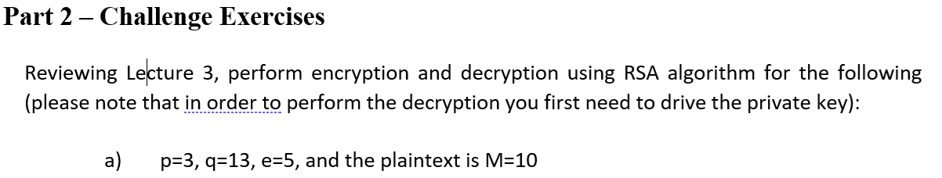
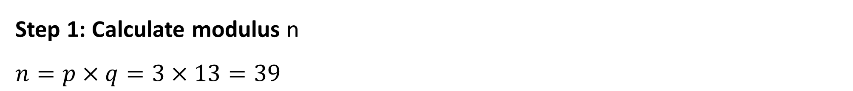
Lab Structure and Activities
Let's solve the RSA encryption and decryption step by step for:
p = 3, q = 13, e = 5, and M = 10
Step 1: Calculate modulus n
$n=p×q=3×13=39$

Slide 33
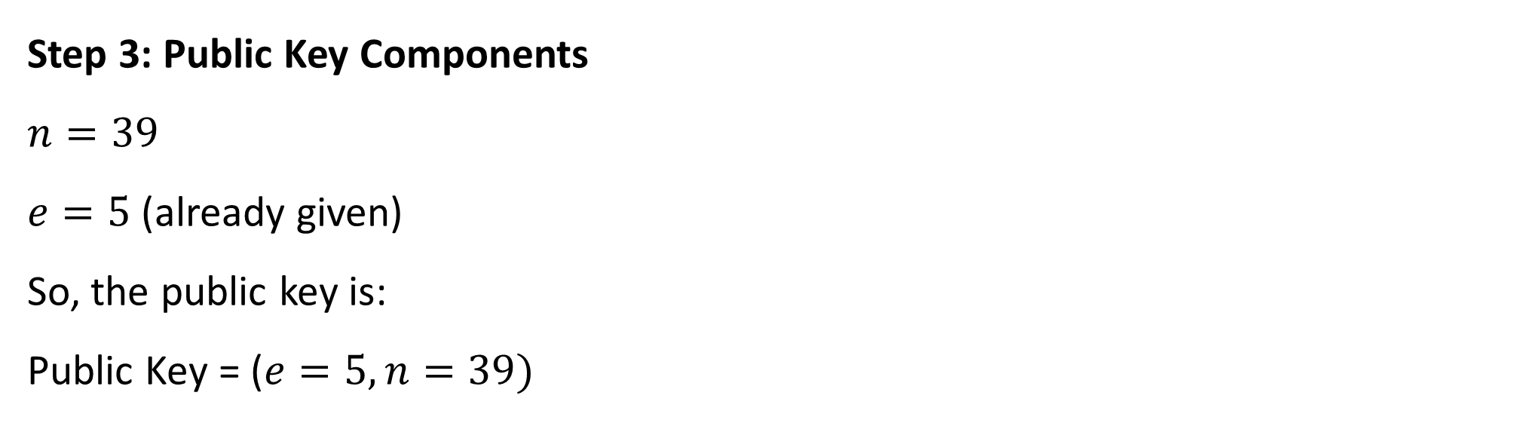
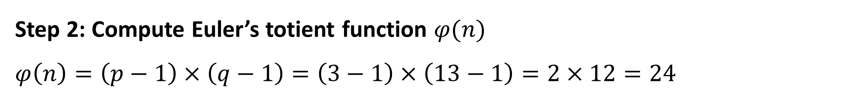
Lab Structure and Activities
Step 2: Compute Euler’s totient function $φ(n)$
$φ\left(n\right)=\left(p−1\right)×\left(q−1\right)=\left(3−1\right)×\left(13−1\right)=2×12=24$
Step 3: Public Key Components
$n=39$
$e=5$ (already given)
So, the public key is:
Public Key = ($e=5, n=39)$

Slide 34

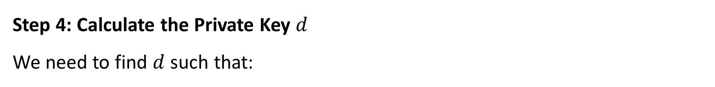
Lab Structure and Activities
Step 4: Calculate the Private Key $d$
We need to find $d$ such that:
$d×e mod φ\left(n\right)=1 (i.e., d×5 mod 24 = 1)$
Try multiples of 5:
$5×1=5 →5 mod 24=5$
$5×2=10 →10 mod 24=10$
$$…$$
$5×19=95 →95 mod 24=1$
$→d=19$

Slide 35
Lab Structure and Activities
So, the private key is:
$Private Key=(d=19, n=39)$

Slide 36
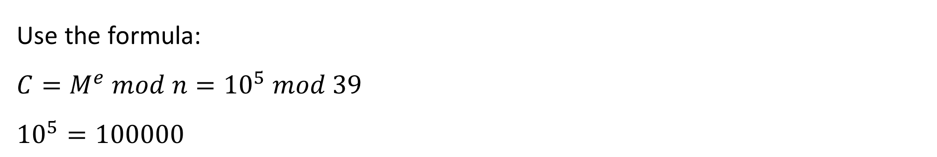
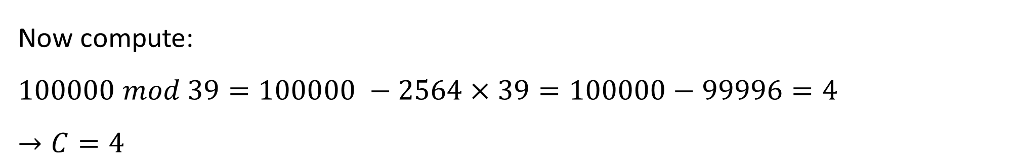
Lab Structure and Activities
Step 5: Encrypt the message $M=10$
Use the formula:
$C=M^{e} mod n={10}^{5} mod 39$
${10}^{5}=100000$
Now compute:
$100000 mod 39=100000 −2564×39=100000−99996=4$
$→C=4$
So, ciphertext = 4

Slide 37
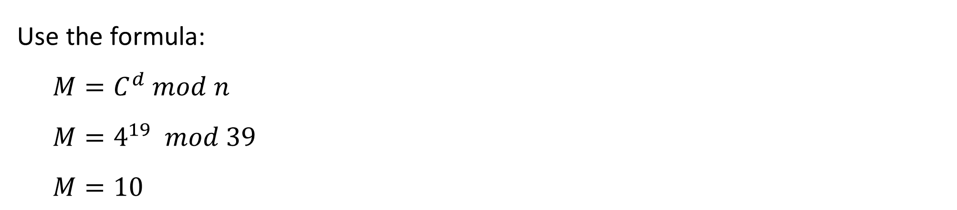
Lab Structure and Activities
Step 6: Decrypt the ciphertext
Use the formula:
$M=C^{d} mod n$
$M=4^{19} mod 39$
$M=10$

Slide 38
Lab Structure and Activities
Final Summary:
Public key: (e = 5, n = 39)
Private key: (d = 19, n = 39)
Plaintext: M = 10
Ciphertext: C = 4
Decrypted Message: M = 10

Slide 39
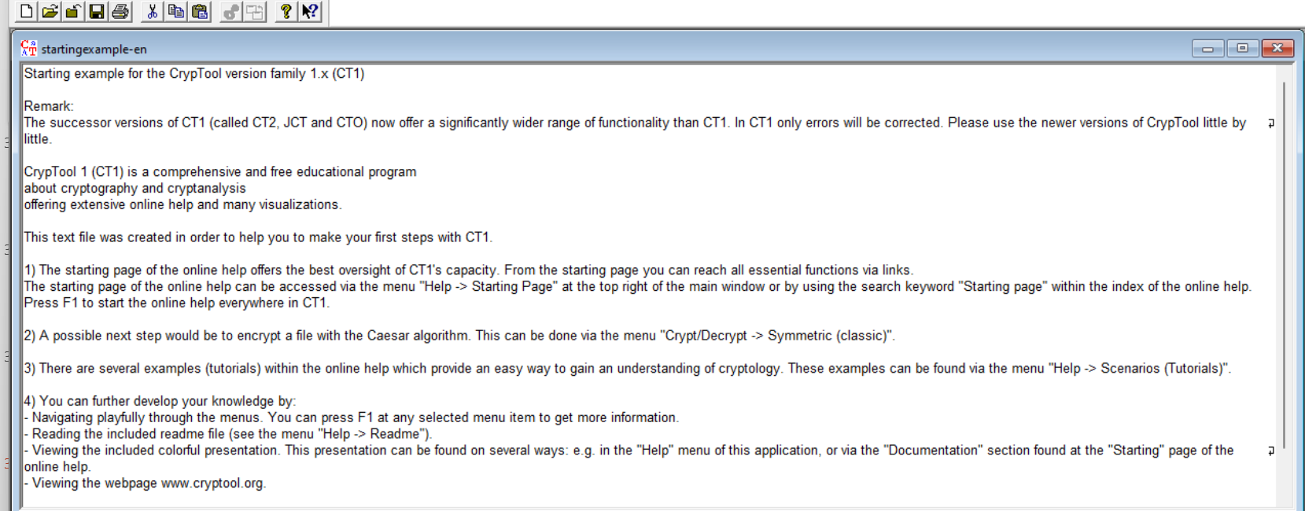
Lab Structure and Activities
Part 3: Caesar Cipher Decryption with CrypTool
Use CrypTool 1.4.42 for this exercise.
Step-by-Step Instructions:
Download from: https://www.cryptool.org/en/ct1/downloads
Install and launch CrypTool 1.4.42
Close the welcome/starting example window

Slide 40
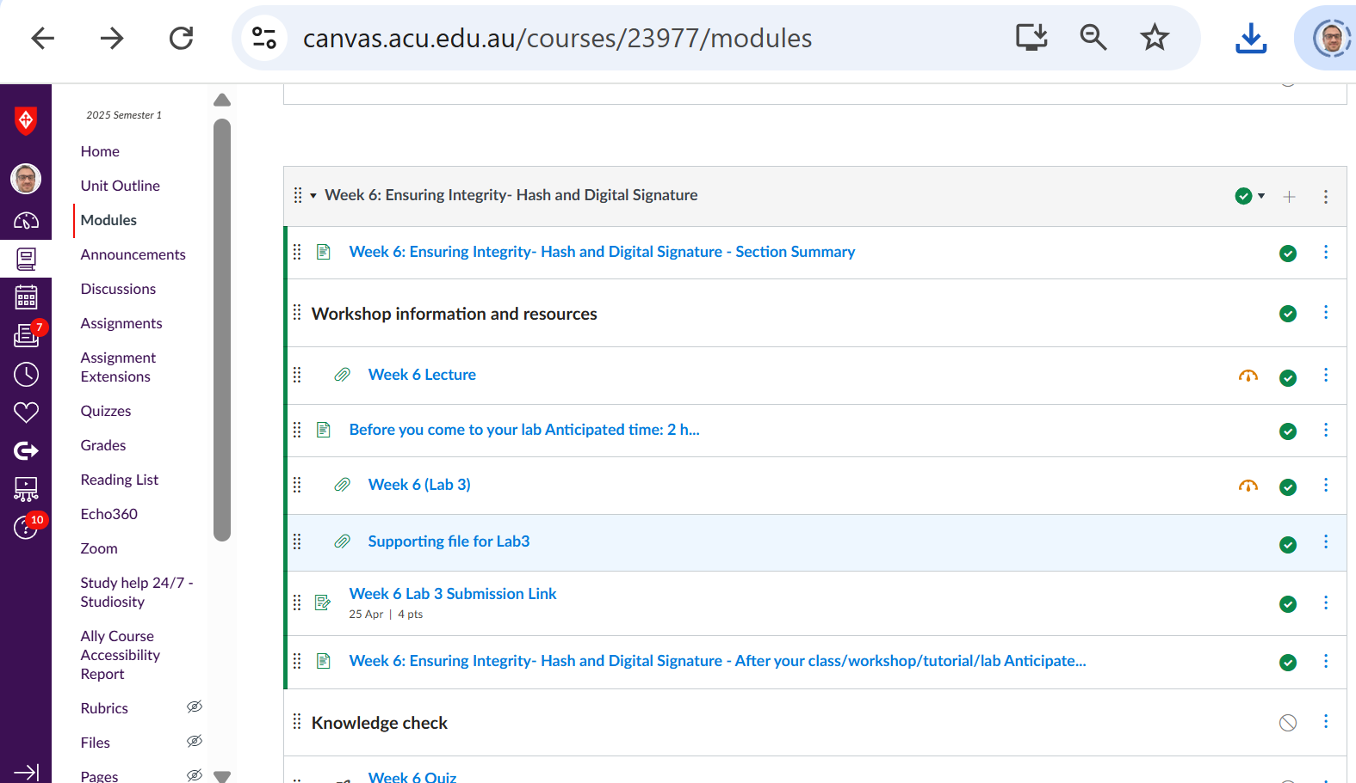
Lab Structure and Activities
Open encrypt-caesar.txt from File > Open

Slide 41
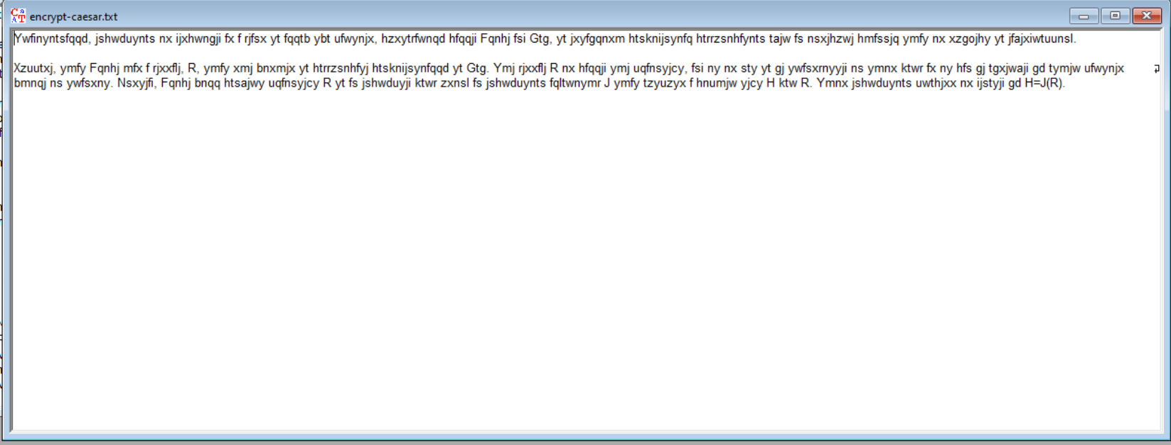
Lab Structure and Activities
View encrypted text (it should appear unreadable)

Slide 42
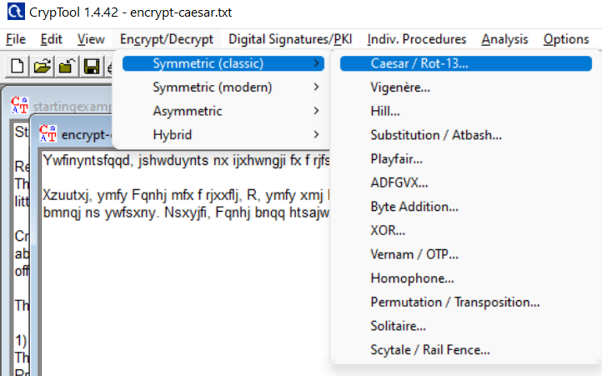
Lab Structure and Activities
You're performing brute-force decryption of a Caesar cipher using CrypTool
Manual Caesar Decryption:
Go to: Encrypt/Decrypt → Symmetric (classic) → Caesar / ROT13
Try decrypting with Number values starting from 1 to 2, 3, … up to 25
After each change, click Decrypt
Look at the decrypted text and see if it looks like meaningful English
Stop when you find readable text

Slide 43
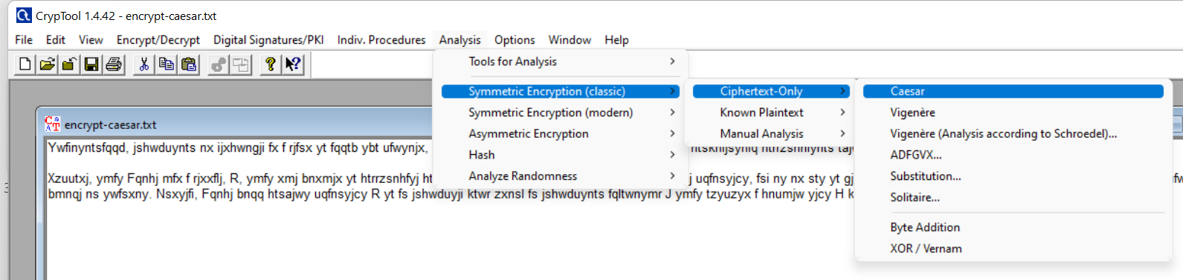
Lab Structure and Activities
Automated Cryptanalysis (Brute Force):
Navigate to: Analysis → Symmetric Encryption (classic) → Ciphertext-only → Caesar
CrypTool will analyze and show the most likely plaintext by testing all Caesar shifts
Confirm if the output matches readable English

Slide 44
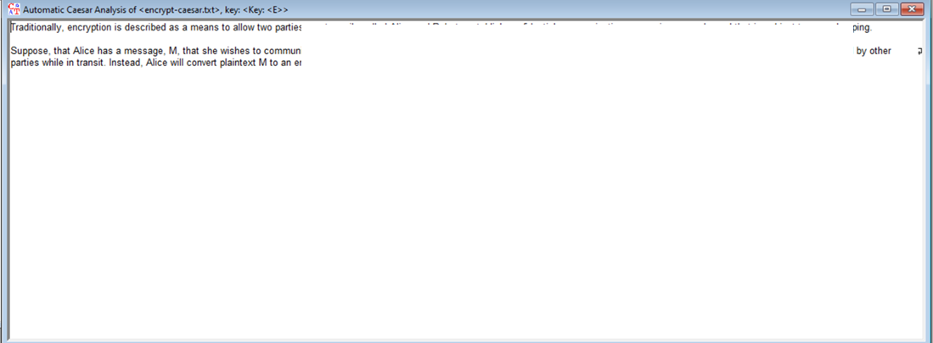
Lab Structure and Activities

Slide 45
Recommended Tools & Workarounds for Mac Users (CrypTool Labs)
Option 1: Use CrypTool 2 or JCrypTool
Both are cross-platform alternatives:
JCrypTool (Java-based)
Platform: Works on macOS, Windows, Linux.
Pros: Open source, runs on Java, user-friendly.
Cons: Interface and features differ from CrypTool 1 (does not have all the same classic crypto features).
Task Compatibility: Has Caesar cipher analysis but layout is different; you can guide students through manual decryption or plugin-based brute-force attacks.

Slide 46
Recommended Tools & Workarounds for Mac Users (CrypTool Labs)
CrypTool 2 (CT2)
Windows only, but can run on Mac using Parallels, VirtualBox, or CrossOver.
More advanced than CT1.
Interface is quite different, and may require extra instruction.

Slide 47
Recommended Tools & Workarounds for Mac Users (CrypTool Labs)
Option 2: Run CrypTool 1 on Mac via Virtual Machine
Mac users can install Windows in a virtual machine:
Install VirtualBox (free): https://www.virtualbox.org/
Install Windows (ISO): Microsoft offers a free 90-day evaluation version for education.
Install CrypTool 1 inside Windows VM.
This method allows students to follow exactly the same steps as Windows users.

Slide 48
Recommended Tools & Workarounds for Mac Users (CrypTool Labs)
Option 3: Online Caesar Cipher Tools (For Simplified Labs Only)
For simple practice:
https://cryptii.com/pipes/caesar-cipher
https://gchq.github.io/CyberChef – powerful for many encryption types.
These tools don’t offer detailed frequency analysis or histograms, but are good for quick experiments and brute force Caesar decryption.

Slide 49
Lab Structure and Activities
What to Avoid
Mistake | X Why It's a Problem
Skipping manual Caesar decryption | You miss understanding brute-force limitations
Using long texts | Slows Caesar brute-force readability
Assuming RSA and AES serve same purposes | They solve different encryption needs
Using non-primes for p and q in RSA | Invalid key generation
Not verifying results in RSA steps | Leads to incorrect encryption/decryption

Slide 50
Lab Structure and Activities
Skills Developed
Conceptual clarity on encryption techniques
RSA math & modular arithmetic
Cryptanalysis techniques with tools
Hands-on software learning (CrypTool)
Real-world encryption/decryption workflow
Troubleshooting and critical thinking in cybersecurity

Slide 51
Lab Structure and Activities
Conclusion and Reflection
This lab gives you both the mathematical foundation and practical insight into how classical and modern cryptographic systems work. From encrypting messages using RSA to analyzing ciphertexts with brute-force techniques in CrypTool, you've stepped into the real-world challenges faced by cryptographers and cybersecurity professionals.
Reflect: How secure are classical methods like Caesar today? Why do we still teach them? What makes modern encryption more resilient?

Slide 52
Submission of Labs & Assessments
These guidelines are designed to support your learning and help you apply necessary techniques effectively. For lab or assessment submissions, please follow instructions and complete tasks based on Canvas. If you have any questions, feel free to ask—I’m happy to help!

Slide 53
Thank You
Have a Great Learning Day!
Feel free to reach out with any questions!
Dr. Farshid Keivanian

